Slide 1
Apprenticeships and their skills content

Slide 2
Institutional context
What are apprenticeships?
Combine workplace experience with off-the-job training
Offered in over 700 occupations from Level 2 (eqvl. GCSEs) to Level 7 (Postgraduate)
Training content set out in regulated Apprenticeship Standards
Available for all age groups
Off-the-job training costs covered by government through Apprenticeship Levy
Why apprenticeships?
Main training policy in England
Flexible: can offer pathways into skilled employment for young people but also upskilling and reskilling opportunities for current workforce
Largely employer-led

Slide 3
Institutional context
Data:
Public information on N. of apprenticeship started under each Apprenticeship Standard (AS) by LAD and month from January 2018 to December 2022
Access to the detailed training content of AS listing Skills, Knowledge and Behaviours apprentices are required to learn → Example
Coming up:
Individual level admin data on apprenticeship starts from the ILR
Can observe apprentices’ individual characteristics
Can distinguish between existing employees and new hires

Slide 4
Institutional context
Evolution of apprenticeship participation
Number of Apprenticeship starts by Age group: 2003-2022
Source: DfE

Slide 5
Skills Content
We have that 0.56% (84) of Apprenticeship Skills are low carbon
Each is classified into three main low carbon categories
64.3% (54) in Decarbonization-buildings
19.0% (16) in Decarbonization-energy
16.7% (14) in Decarbonization-transport
These are distributed across 40 different Apprenticeship Standards

Slide 6
Supply of low-carbon skills through Apprenticeships

Slide 7
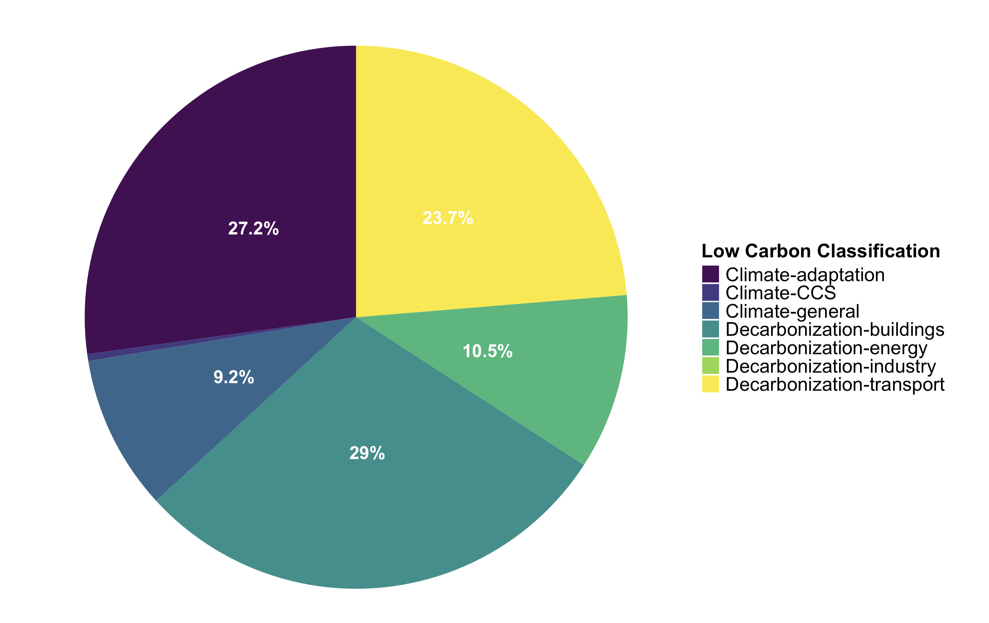
III-Supply of low-carbon skills
What type of low-carbon skills are apprentices being trained in?
% of low-carbon skills delivered by low-carbon category
Climate Adaptation and Transport-related low-carbon skills are much more prominent among training than in online job ads.
Much less focus on general low-carbon skills and on energy
Only skills linked to decarbonising buildings are equally represented

Slide 8
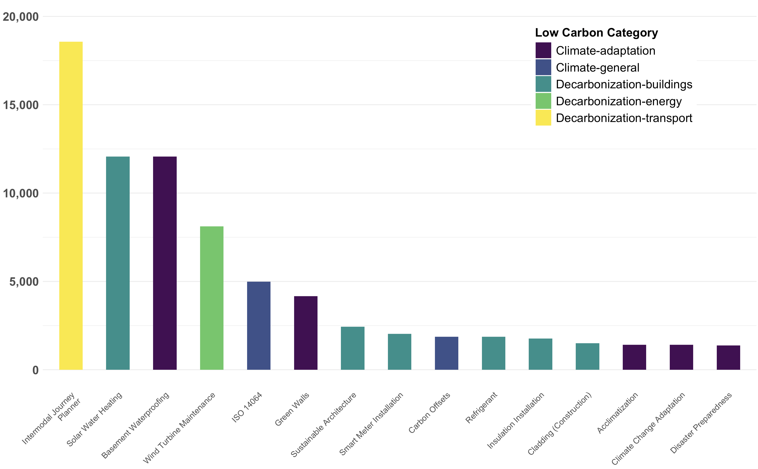
III-Supply of low-carbon skills
What are the most popular low-carbon skills started?
Top 15 most popular AS skills started: 2018-2022

Slide 9
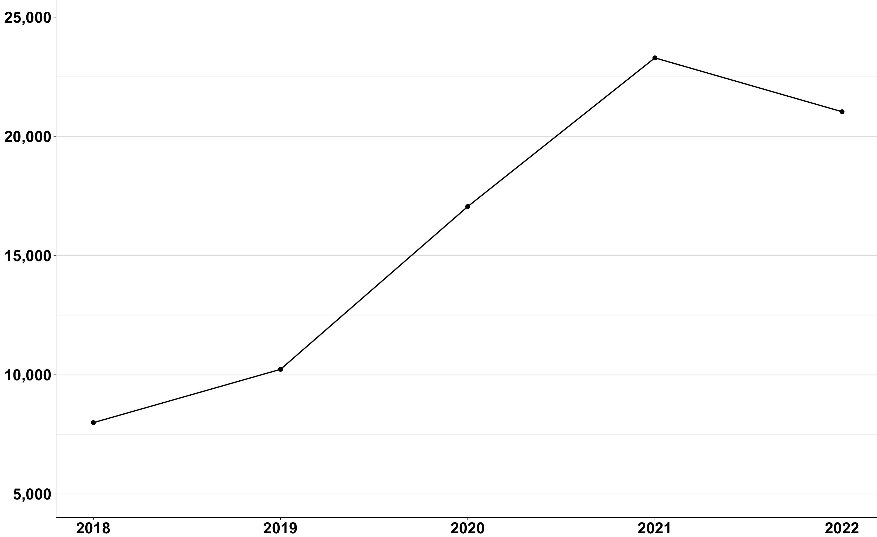
III-Supply of low-carbon skills
Training in low-carbon skills has increased in the last years
Number of low-carbon skills delivered through AS over time: 2018-2022
Source: Own calculations on DfE data

Slide 10
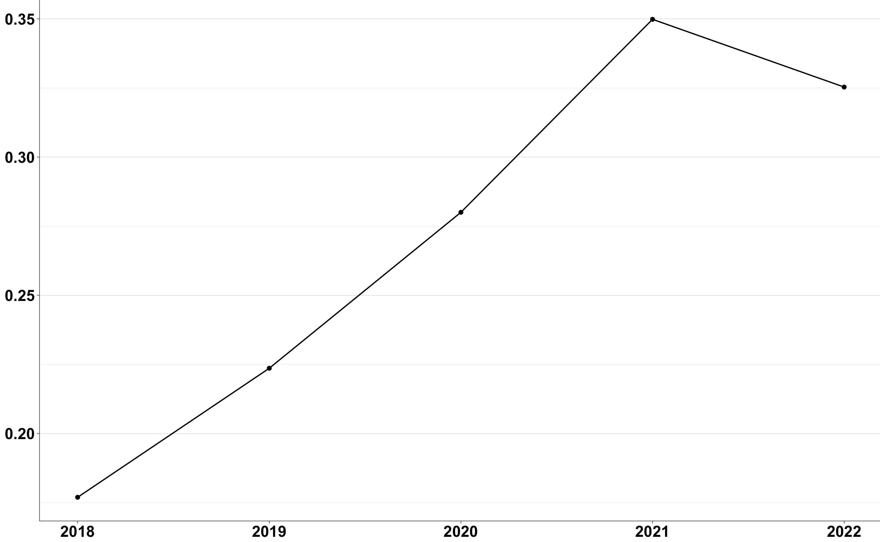
III-Supply of low-carbon skills
Proportion of low-carbon training has increased over the last few years
% of low-carbon skills delivered over time: 2018-2022
Proportion of low-carbon skills delivered has increased by less than in job ads: only 1.9 times vs. 2.8
Source: Own calculations on DfE data

Slide 11
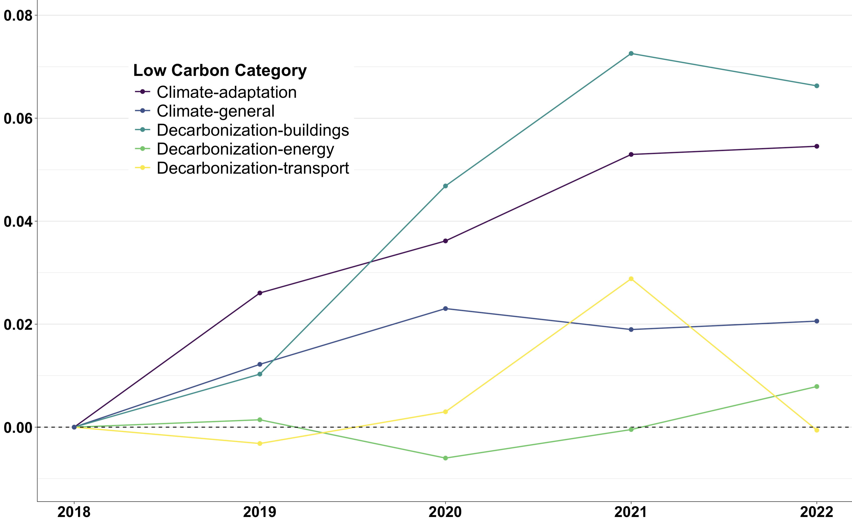
III-Supply of low-carbon skills
Increase in low-carbon training driven by only few types of skills
% of low-carbon skills delivered over time by category: 2018-2022
Training in low-carbon skills related to adaptation and decarbonisation of buildings has increased at the fastest pace in last few years
This is despite demand for adaptation low-carbon skills has actually stagnated
No change in supply of low-carbon skills for renewable energy, despite fastest increase in demand
Decarbonising buildings
Climate - adaptation
Climate - general
Decarbonising energy
Decarbonising transport
Source: Own calculations on DfE data

Slide 12
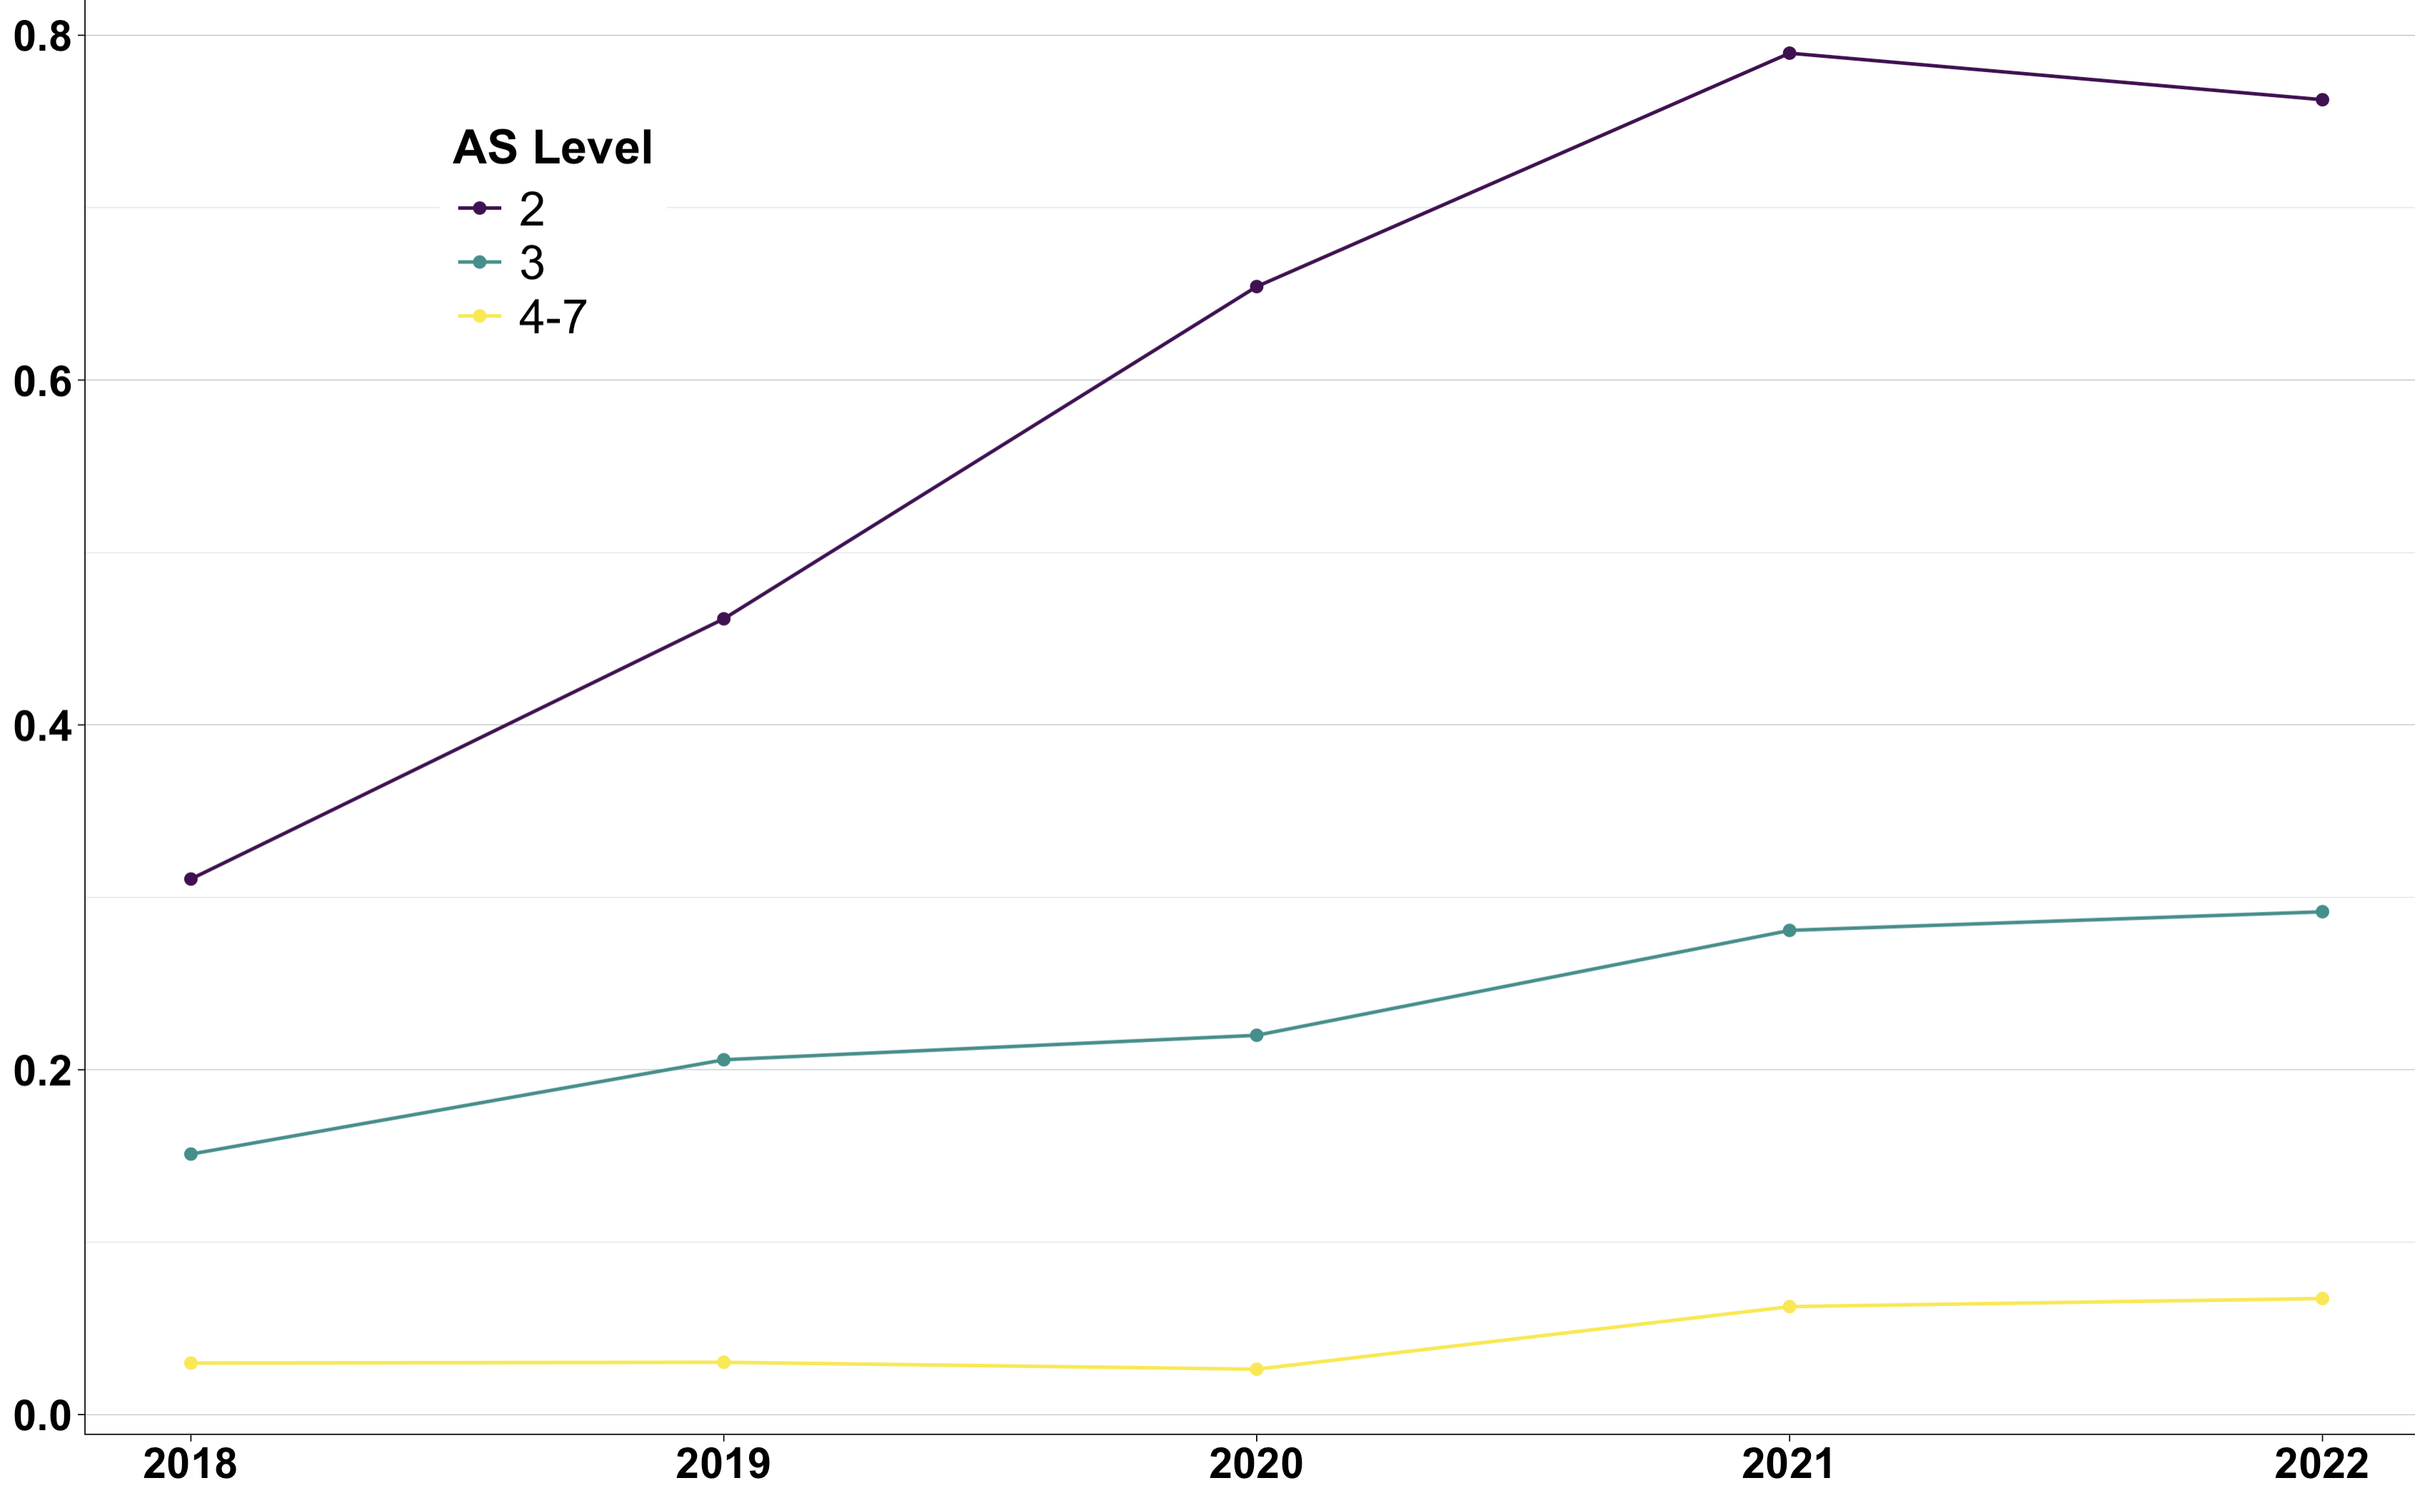
III-Supply of low-carbon skills
Increase in low-carbon training driven by Level 2
% of low-carbon skills delivered over time by Apprenticeship Standard level: 2018-2022
Level 2
Level 3
Level 4-7
Source: Own calculations on DfE data

Slide 13
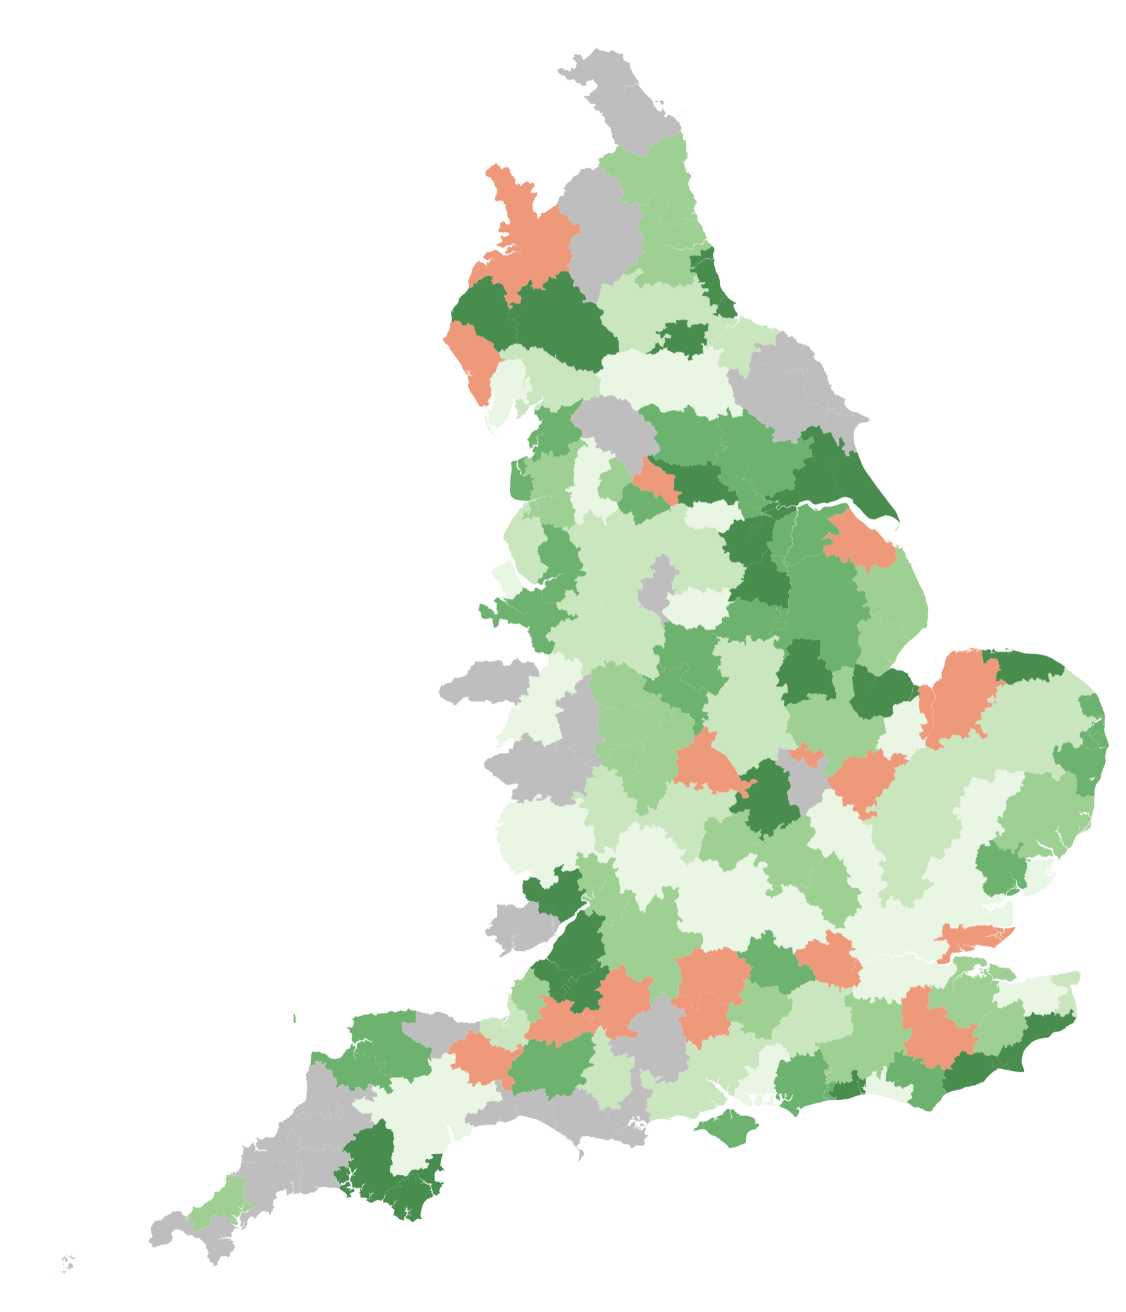
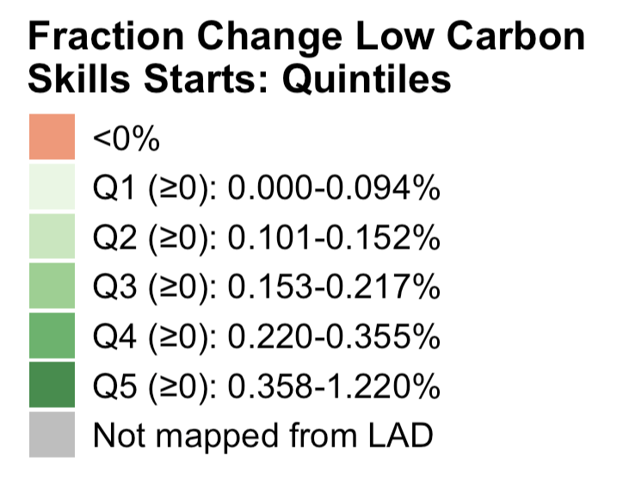
III-Supply of low-carbon skills
Low-carbon training increased the most in NE and parts of SW
Change in % low-carbon skills in training across TTWAs: 2018-2022
Except for few areas (e.g. Severn estuary, Humberside) changes in demand and supply do not seem very aligned
Source: Own calculations on DfE data

Slide 14
Conclusion and next steps
Some (preliminary) conclusions:
Both demand for low-carbon skills and supply though apprenticeship training have increased in recent years… but supply more slowly
At first glance, low-carbon skills people are training in through apprenticeships are not well-aligned with demand
Possible explanations:
Online job ads not representative of labour market served by apprenticeships
Need to reweight accordingly once we have info on occupation
Semantic matching still faulty
Could directly classify AS skills as low-carbon or not using Chat GPT
Genuine mismatch: incentives of learners and apprenticeship-offering firms not aligned with wider market?
Estimate supply elasticity to changes in demand for low-carbon skills with proper model
Explore whether this is due to firms not offering apprenticeships or lack of interest from learners

Slide 15
Thank you!
Comments very welcome:
g.ventura@lse.ac.uk

Slide 16
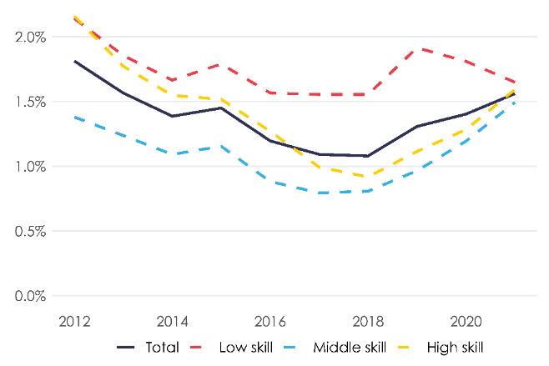
Increase in green skills concentrated among high- and medium-skilled occupations
Percentage of job ads that contain at least one green skill by occupational group (2012-2021)
Source: Sato et al. (2023)
 Back
Notes:
Notice that the fraction is higher in this plot because it refers to the fraction of job ads containing at least low-carbon skill whereas we plot the fraction of overall skill demanded that are low-carbon. If low-carbon ads contain/demand more skills then the proportion will be lower as it is the case here.

Slide 17
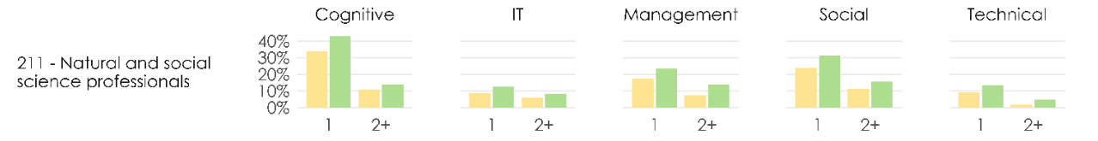
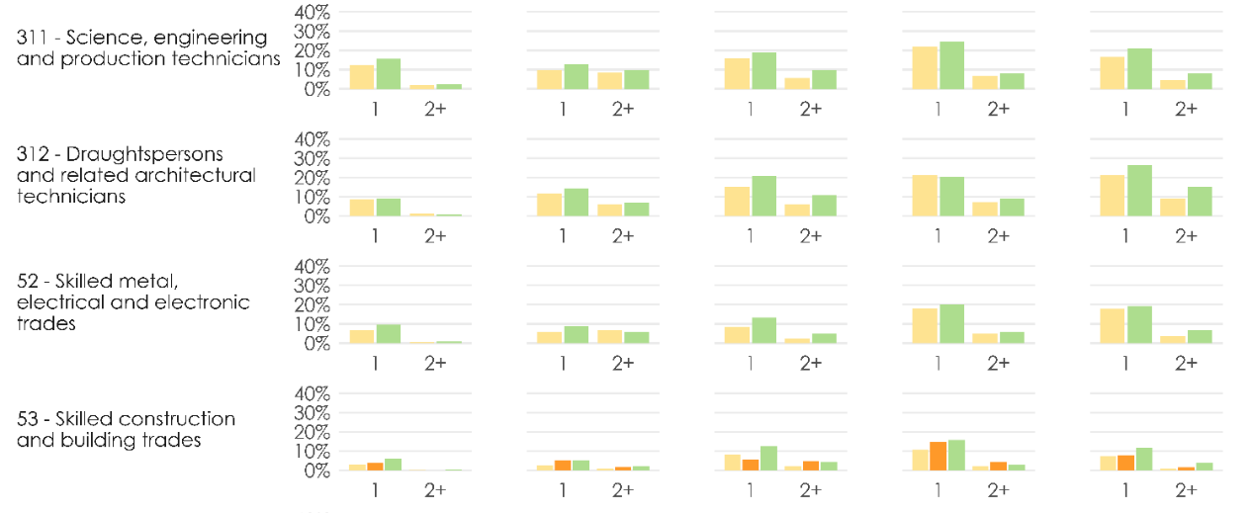

Green skills more likely to appear alongside Cognitive, Social and technical skills
Percentage of job ads that contain at least one or more than one skill of particular type by whether job is green or not
Source: Sato et al. (2023)
 Back
Notes:
Ideally I would like to replicate this figure to be able to see at green job ads as a whole and with a focus on Technical skills – as this can partly motivate the interest in apprenticeships

Slide 18
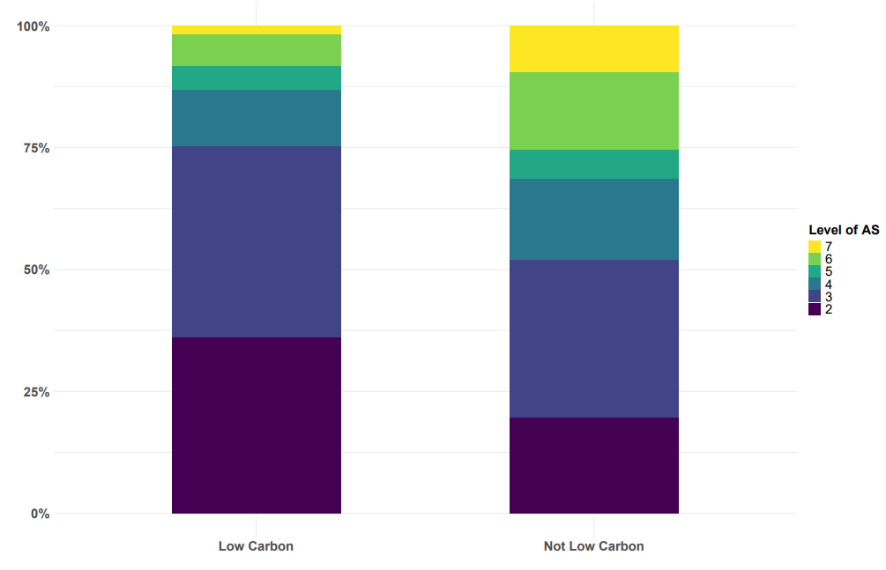
Appendix
At what level are low-carbon standards more common?
% of AS at different levels by whether low-carbon or not
Source: Own computation on IFATE data.
 Back

Slide 19
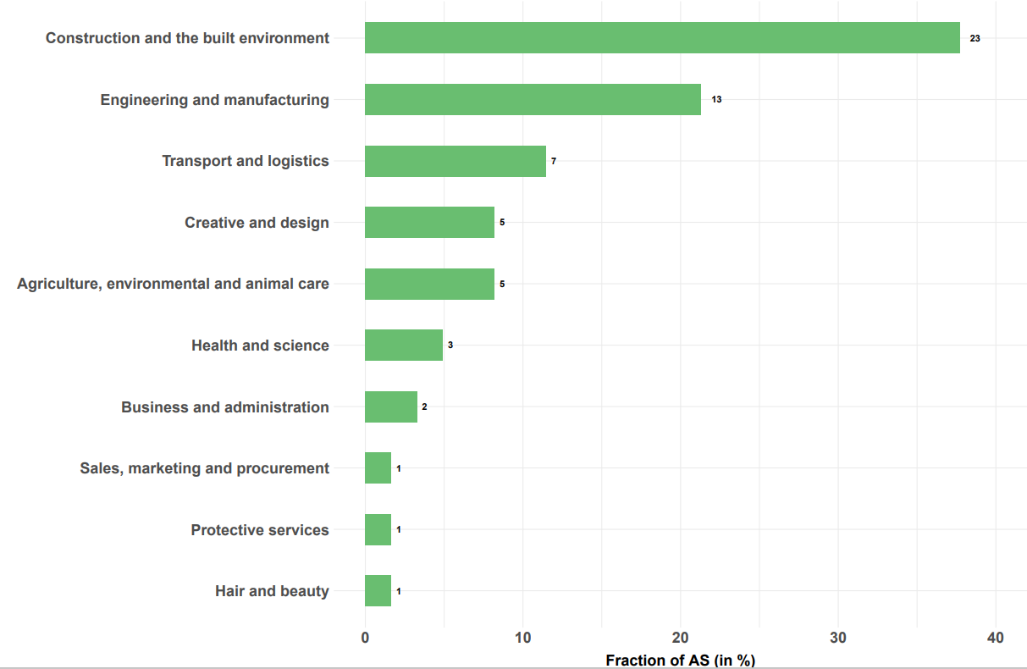
Appendix
In what sectors are low-carbon standards more common?
Distribution of low-carbon AS across “Routes”
 Back
Source: Own computation on IFATE data.

